Slide 1
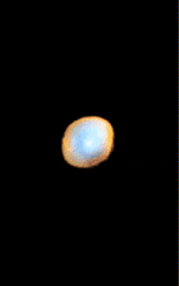
Singularis

Slide 2
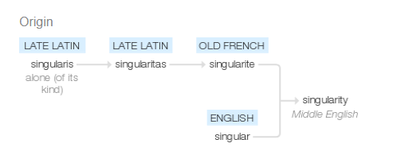
Game Etymology
“Singularis”

Slide 3
Game Overview
“Alone” on a spaceship hurdling toward a black hole.
Escape?
Decisions?

Slide 4
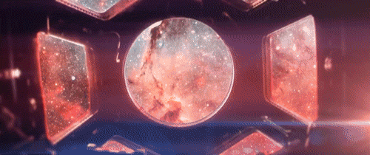
Theorists
Bogost
Winner
  Engels
Brock

Slide 5
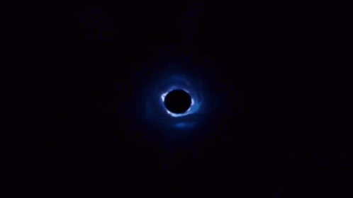
Relation to my Work
Affect theory – gynoids, feminism.

